Slide 1





PUSILKOM UI TRAINING
Directorate General of Taxes (DJP)
MLOps Planning and Design
Day 3: From Pipeline to Production
CI/CD/CT Design · Deployment Strategies · Monitoring & Observability · Incident Handling
Made Harta Dwijaksara, Ph.D.
Copyright 2026 | Pusilkom UI · supported by GIZ

Slide 2
OVERVIEW
Day 3 Agenda
01
CI/CD/CT Design for Machine Learning
08:30–10:30
MLflow model tracking & model registry, alias @champion
02
Machine Learning Deployment Strategies
10:45–12:00
Serving with FastAPI and Containerisation
03
Monitoring and Observability
13:15–14:45
Structured logging, data drift detection with Evidently AI, retraining policy
04
Orchestration and Incident Handling
15:00–16:00
orchestration with Prefect and incident response
Notes:
All four sessions use ONE pipeline. Each session adds one link to the chain; they are not separate exercises.

Slide 3
Where Day 3 Fits in the Programme
CONTEXT
Day 1
Day 2
Day 3 — today
Foundations & governance
Data & reproducibility
Operating models in production
DevOps vs MLOps
Data privacy
MLOps maturity assessment
MLSecOps
Data management & feature stores
Data pipelines
Reproducibility & versioning (DVC)
Repositories, containers, registries
CI/CD/CT
Deployment strategies
Monitoring & observability
Incident handling
3
Notes:
Bridge from Day 1 (maturity, privacy, MLSecOps) and Day 2 (data, versioning, containers). DVC was covered on Day 2, so today the data is already in the repo.

Slide 4
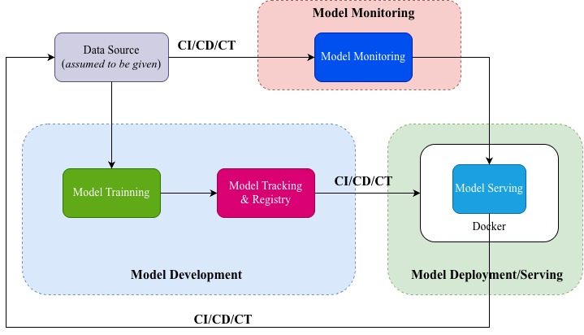
Our Today’s Journey for MLOps
Topics
4
Notes:
The environment is assumed ready. Run make preflight on every machine before the day (and PROJECT_ID=<id> make preflight-cloud with a participant account). If a participant cannot run make test, hand them to an assistant (Tara/Naufal) so the session keeps moving. Windows without WSL/Git Bash has no make: run the python commands shown in the README directly.

Slide 5
MLOps Tools for CI/CD/CT
Topics
No | Phase | Tools
1 | Model Development | Scikit-learn, XGBoost, TensorFlow, PyTorch, Keras, Spark Mlib, etc.
2 | Model Tracking and Registry | MLFlow, Databricks, Clear ML, Comet, Kubeflow, Valohai, etc.
3 | Model Deployment Env. | Docker Desktop, Google Cloud Run, AWS, etc.
4 | Model Deployment | FAST API, Flask, BentoML, SageMaker, Kserve, etc.
5 | Model Monitoring | Evidently AI, NannyML, Arize AI, Fiddler AI, WhyLabs, etc.
6 | Orchestration | Prefect, ZenML, Airflow, Kubeflow, etc.
4
Notes:
The environment is assumed ready. Run make preflight on every machine before the day (and PROJECT_ID=<id> make preflight-cloud with a participant account). If a participant cannot run make test, hand them to an assistant (Tara/Naufal) so the session keeps moving. Windows without WSL/Git Bash has no make: run the python commands shown in the README directly.

Slide 6
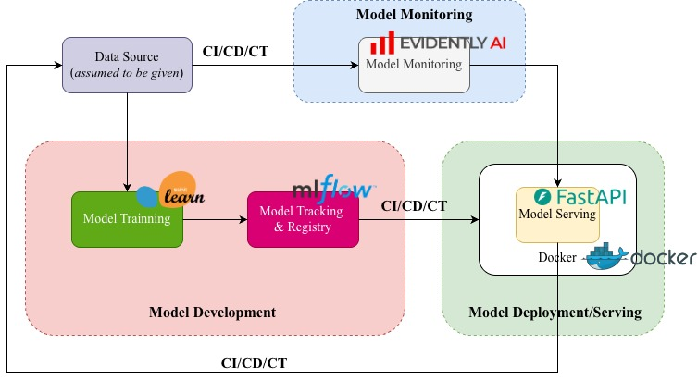
Our Today’s Journey for MLOps
Topics
4
Notes:
The environment is assumed ready. Run make preflight on every machine before the day (and PROJECT_ID=<id> make preflight-cloud with a participant account). If a participant cannot run make test, hand them to an assistant (Tara/Naufal) so the session keeps moving. Windows without WSL/Git Bash has no make: run the python commands shown in the README directly.

Slide 7
MLOps Dataset
Topics
Binary classification: approved (0/1)
File | Rows | Role
data/train.csv | 1,500 | Training
data/test.csv | 500 | Evaluation & monitoring reference
data/production.csv | 500 | 'Production' data with deliberate drift
8 numeric features: age, income, bmi, tenure_months, num_claims, credit_score, policy_value, risk_score.
4
Notes:
The environment is assumed ready. Run make preflight on every machine before the day (and PROJECT_ID=<id> make preflight-cloud with a participant account). If a participant cannot run make test, hand them to an assistant (Tara/Naufal) so the session keeps moving. Windows without WSL/Git Bash has no make: run the python commands shown in the README directly.

Slide 8
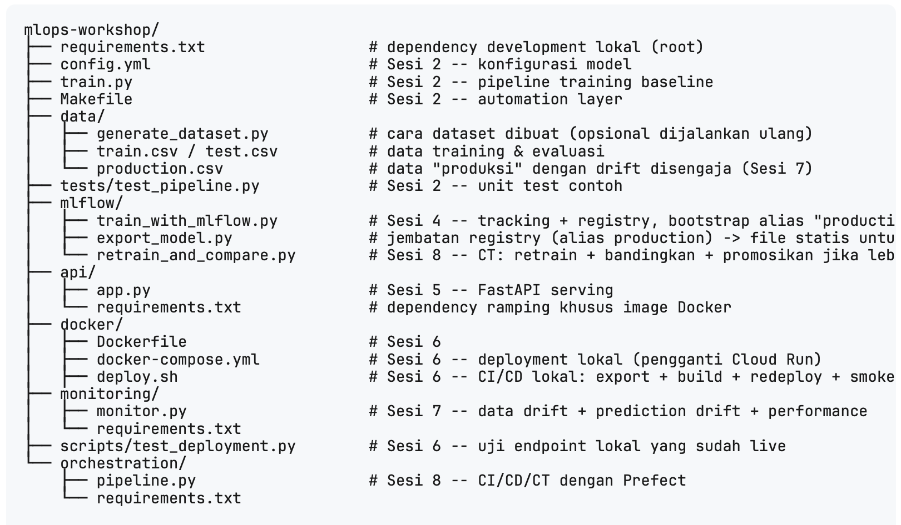
Source Code Structures
Topics
https://github.com/madeharta/latest-mlops-workshop
4
Notes:
The environment is assumed ready. Run make preflight on every machine before the day (and PROJECT_ID=<id> make preflight-cloud with a participant account). If a participant cannot run make test, hand them to an assistant (Tara/Naufal) so the session keeps moving. Windows without WSL/Git Bash has no make: run the python commands shown in the README directly.

Slide 9
The Prepared Repo & Environment
ENVIRONMENT
Already on every laptop / VM
bash — terminal
# quick check (1 minute)
$ source venv/bin/activate
$ python --version
Python 3.11.x
$ python -c "import numpy as n; print(n.__version__)"
1.26.4 # must be < 2
$ make test
2 passed
$ make preflight # PASS/WARN/FAIL
VSCode installed or any other editor
mlops-workshop repo cloned from GitHub
Python >3.10 with an active virtual environment
Dependencies from requirements.txt (pinned)
Prefect installed from orchestration/requirements.txt
Train / test / production data already in data/
Docker available (deployment session)
4
Notes:
The environment is assumed ready. Run make preflight on every machine before the day (and PROJECT_ID=<id> make preflight-cloud with a participant account). If a participant cannot run make test, hand them to an assistant (Tara/Naufal) so the session keeps moving. Windows without WSL/Git Bash has no make: run the python commands shown in the README directly.

Slide 10
IN THIS SESSION
01
01
CI, CD and CT for ML
CI/CD/CT Design for Machine Learning
02
MLflow experiment tracking
03
Exploring MLflow features
04
Aliases instead of stages
08:30–10:30
05
Mlflow model Registry
06
Exercise and Discussion

Slide 11
CI, CD and CT in Machine Learning
CONCEPT
CI
CD
CT
Continuous Integration
Continuous Delivery / Deployment
Continuous Training
Every code change is tested automatically
In ML: also test the data and model quality
Example: pytest + quality gate
Artefacts that pass tests are released automatically
In ML: the artefact is an image + a specific model version
Example: build image → Cloud Run
The model is retrained when the data changes
Triggered by a schedule, new data, or drift
Example: monitor → retrain → registry
We will defer this section to the end of workshop after all topics are complete
7
Notes:
Key point: software has one source of change (code); ML has two (code and data). That is why ML needs CT: retraining when the data changes, not only when the code changes.

Slide 12
The Three MLflow Components We Use
COMPONENTS
01
Tracking
02
Model Registry
03
MLflow UI
Records the parameters, metrics and artefacts of every run: log_param, log_metric, log_model.
A catalogue of models with version numbers and aliases (@champion). The basis for release and rollback.
A dashboard to compare runs: sort, filter and plot metrics across experiments.
9

Slide 13
Why Experiment Tracking Matters
PROBLEM
01
Lost version details
02
Hard to compare
"Which model gave us 93% accuracy?" Without tracking, the honest answer is often "I don't remember".
Notebook prints vanish when the kernel restarts. There is no systematic way to compare dozens of runs.
03
Collaboration clashes
04
No audit trail
Two people train similar models without knowing, duplicating work or overwriting each other's results.
A production model cannot be traced back to the code, data and parameters that produced it.
8

Slide 14
Tracking Backend: SQLite, Not a File Store
⚠ VERSION FINDING
ROOT CAUSE
FIX
The folder-based backend (file:///.../mlruns) is in maintenance mode in recent MLflow releases and may be rejected when set_experiment() is called.
Use a SQLite backend. It stays local (a single mlflow.db file), needs no separate database server, and is fully supported.
OR
http://domain:port is also working, but it requires MLFLow server already started
mlflow.set_tracking_uri("sqlite:///mlflow.db") # CORRECT
# mlflow.set_tracking_uri(”http://127.0.0.1:9001") # CORRECT → but requires MLFLOW server running
# mlflow.set_tracking_uri("file:///.../mlruns") # avoid
10
Notes:
A real gotcha found while testing on MLflow 3.16. Do not switch to file:// even if an older tutorial uses it.

Slide 15
MLflow API Structure
⚠ VERSION FINDING
MLflow
Fluent Tracking API
MLflowClient
start_run()
set_experiment()
log_metric()
log_param()
log_artifact()
….
Registry management
Model version
Aliases
Tags
Search
….
10
Notes:
A real gotcha found while testing on MLflow 3.16. Do not switch to file:// even if an older tutorial uses it.

Slide 16
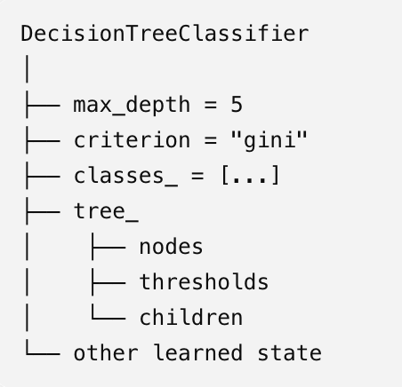
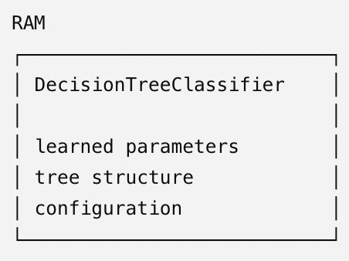
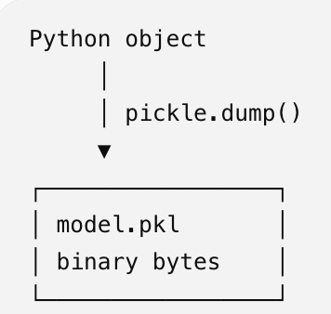
A Note about Model Format
⚠ VERSION FINDING
In this workshop, we mainly use python with scikit-learn framework for model development.
Define object in Python
How object lives in RAM
Dumping (logging) Object
Scikit-Learn : Pickle / joblib / skops → .pkl, .joblib, .skops
Xboost : JSON / UBJSON → .json, .ubj
TensorFlow : SavedModel → directory
Keras : Keras v3 format → .kreas
PyTorch : state_dict / PyTorch serialization → .pt, .pth
10
Notes:
A real gotcha found while testing on MLflow 3.16. Do not switch to file:// even if an older tutorial uses it.

Slide 17
Run Three Experiments at Once
HANDS-ON 1
bash — terminal (real output)
$ make mlflow
DecisionTree: acc=0.8740 auc=0.9075 f1=0.8706
RandomForest: acc=0.9380 auc=0.9817 f1=0.9350
GradientBoosting: acc=0.9380 auc=0.9804 f1=0.9347
BEST: RandomForest (accuracy=0.9380)
Registered version: 1
Alias 'champion' -> version 1
$ make ui # mlflow ui --backend-store-uri sqlite:///mlflow.db --port 5001
13
Notes:
~10 minutes. The figures below are real output from the repo. Re-running creates versions 2, 3, … — that is expected.

Slide 18
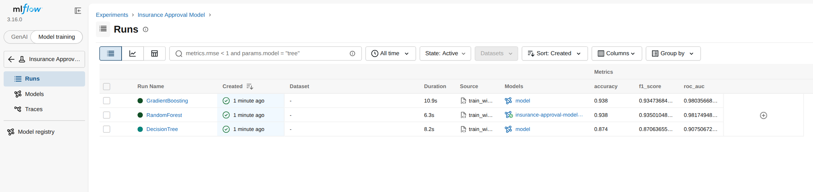
MLflow UI — Comparing Runs
REAL SCREENSHOT
Model training toggle
Columns → metrics
Models column
The UI opens in GenAI mode by default. Switch to Model training for classic runs.
Add accuracy, f1_score and roc_auc, then click a header to sort.
The RandomForest run links to insurance-approval-model in the registry.
14
Notes:
In MLflow 3.16, switch the toggle to 'Model training' (top left). Add metric columns with the Columns button. The MLflow Assistant panel on the right can be closed.

Slide 19
Instrumenting Training with MLflow
CODE
Experiments Tracking: manual logging (train_with_mlflow.py)
mlflow/train_with_mlflow.py
mlflow.set_tracking_uri("sqlite:///mlflow.db")
mlflow.set_experiment("Insurance Approval Model")
for name, (ModelClass, params) in MODELS.items(): # DecisionTree, RandomForest, GradientBoosting
with mlflow.start_run(run_name=name) as run:
model = ModelClass(**params, random_state=42)
model.fit(X_train, y_train)
preds = model.predict(X_test)
proba = model.predict_proba(X_test)[:, 1]]]
for k, v in params.items():
mlflow.log_param(k, v)
mlflow.log_metric("accuracy", accuracy_score(y_test, preds))
mlflow.log_metric("roc_auc", roc_auc_score(y_test, proba))
mlflow.log_metric("f1_score", f1_score(y_test, preds))
model_info = mlflow.sklearn.log_model(model, name="model")
…
11

Slide 20
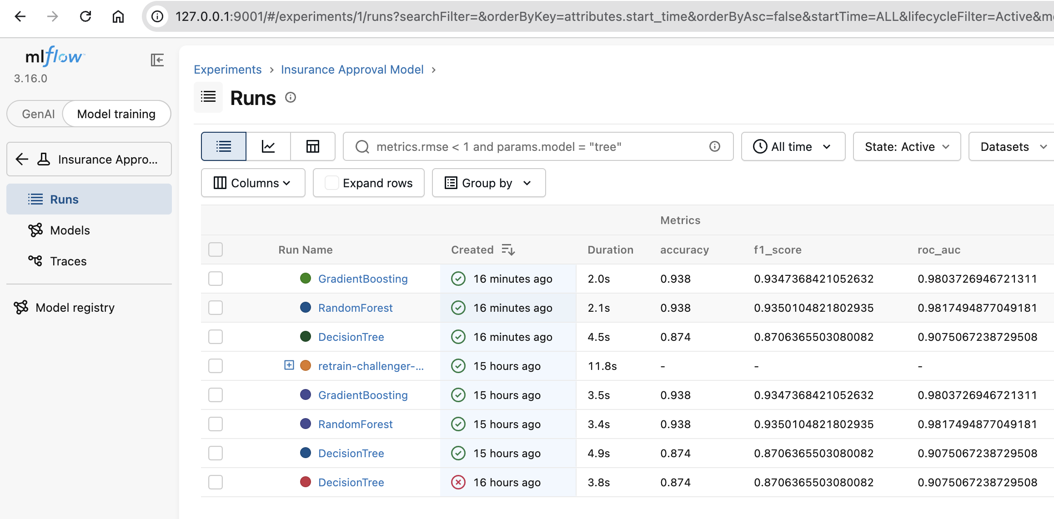
Instrumenting Training with MLflow
CODE
Experiments Tracking: manual logging
11

Slide 21
Autologging with MLflow
CODE
Experiments Tracking: auto-logging (train_with_mlflow_autologing.py)
mlflow/train_with_mlflow.py
mlflow.set_tracking_uri("sqlite:///mlflow.db")
mlflow.set_experiment("Insurance Approval Model")
mlflow.sklearn.autolog(
log_input_examples=True,
log_model_signatures=True,
log_models=True
)
for name, (ModelClass, params) in MODELS.items(): # DecisionTree, RandomForest, GradientBoosting
with mlflow.start_run(run_name=name) as run:
model = ModelClass(**params, random_state=42)
model.fit(X_train, y_train)
preds = model.predict(X_test)
proba = model.predict_proba(X_test)[:, 1]]]
mlflow.log_metric("accuracy", accuracy_score(y_test, preds))
mlflow.log_metric("roc_auc", roc_auc_score(y_test, proba))
mlflow.log_metric("f1_score", f1_score(y_test, preds))
….
MLFlow is designed to observe ML model training, thus information from prediction is not included in auto-logging information and must be manually logged
11

Slide 22
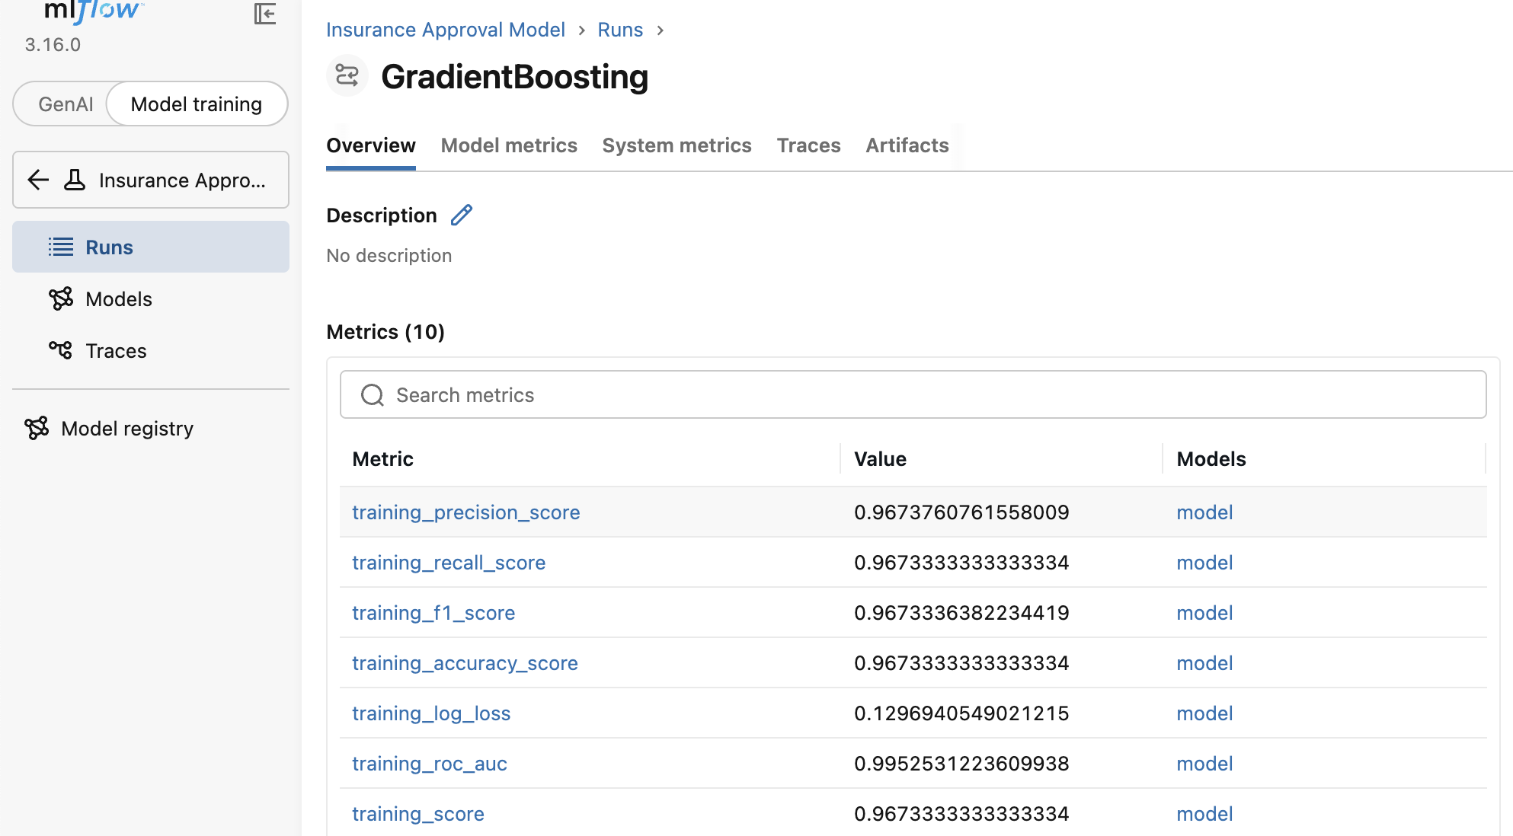
Autologging with MLflow
CODE
Experiments Tracking: auto-logging (train_with_mlflow_autologing.py)
Auto-Logging information
Model parameters and hyperparameters
Training and validation metrics
Model artifacts and checkpoints
Training plots and visualizations
Framework-specific metadata
https://mlflow.org/docs/latest/ml/tracking/autolog/
11

Slide 23
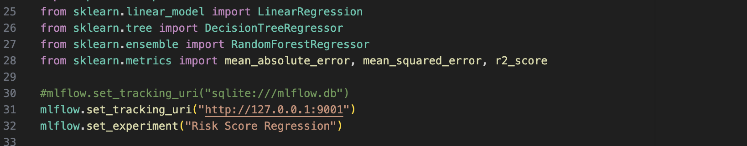
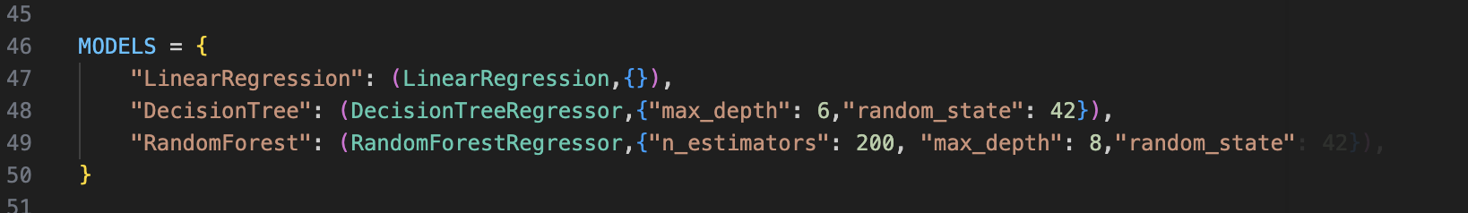
Autologging with MLflow
CODE
Classification vs Regression Logging(ztrain_with_mlflow_regression.py)

Slide 24
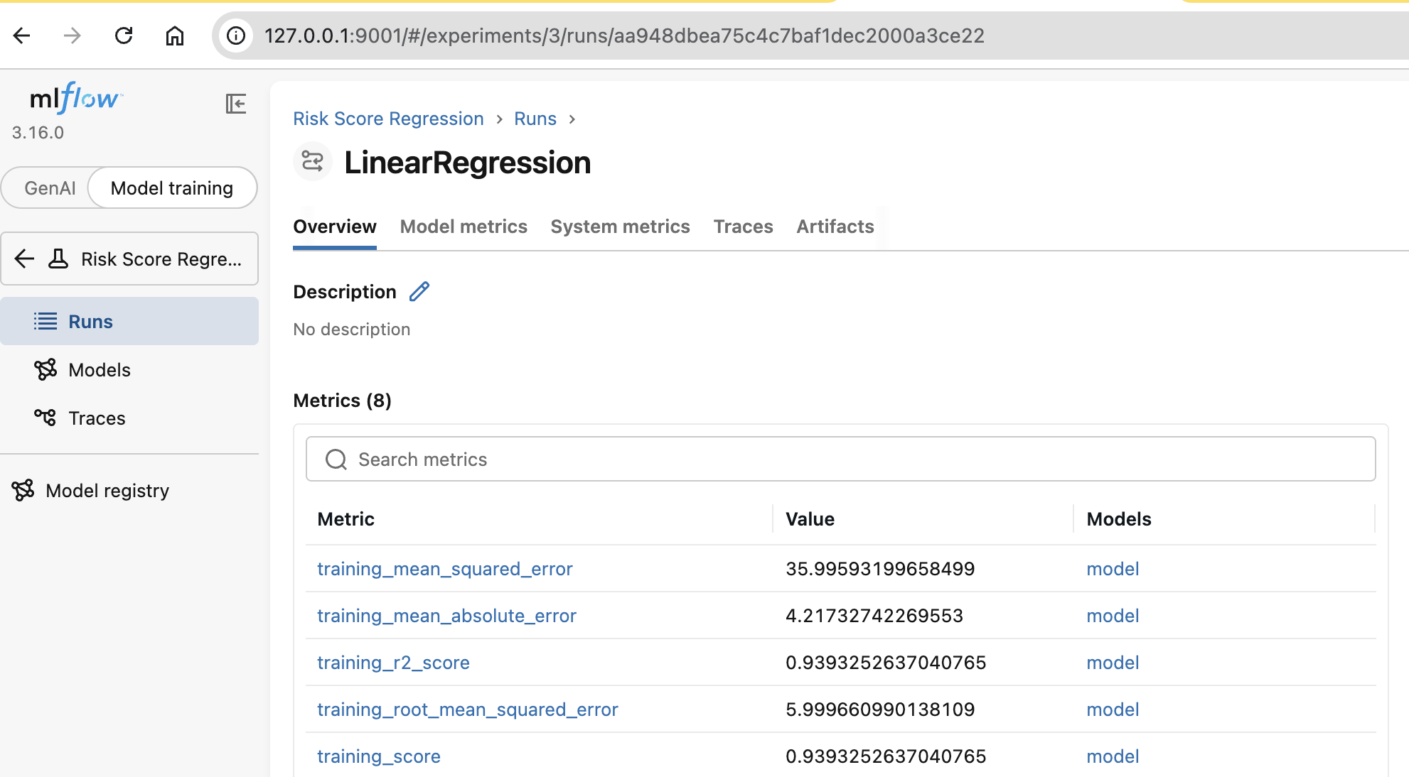
Autologging with MLflow
CODE
Classification vs Regression Logging(ztrain_with_mlflow_regression.py)
Metrics yang di log disesuaikan secara otomatis oleh mekanisme autologging

Slide 25
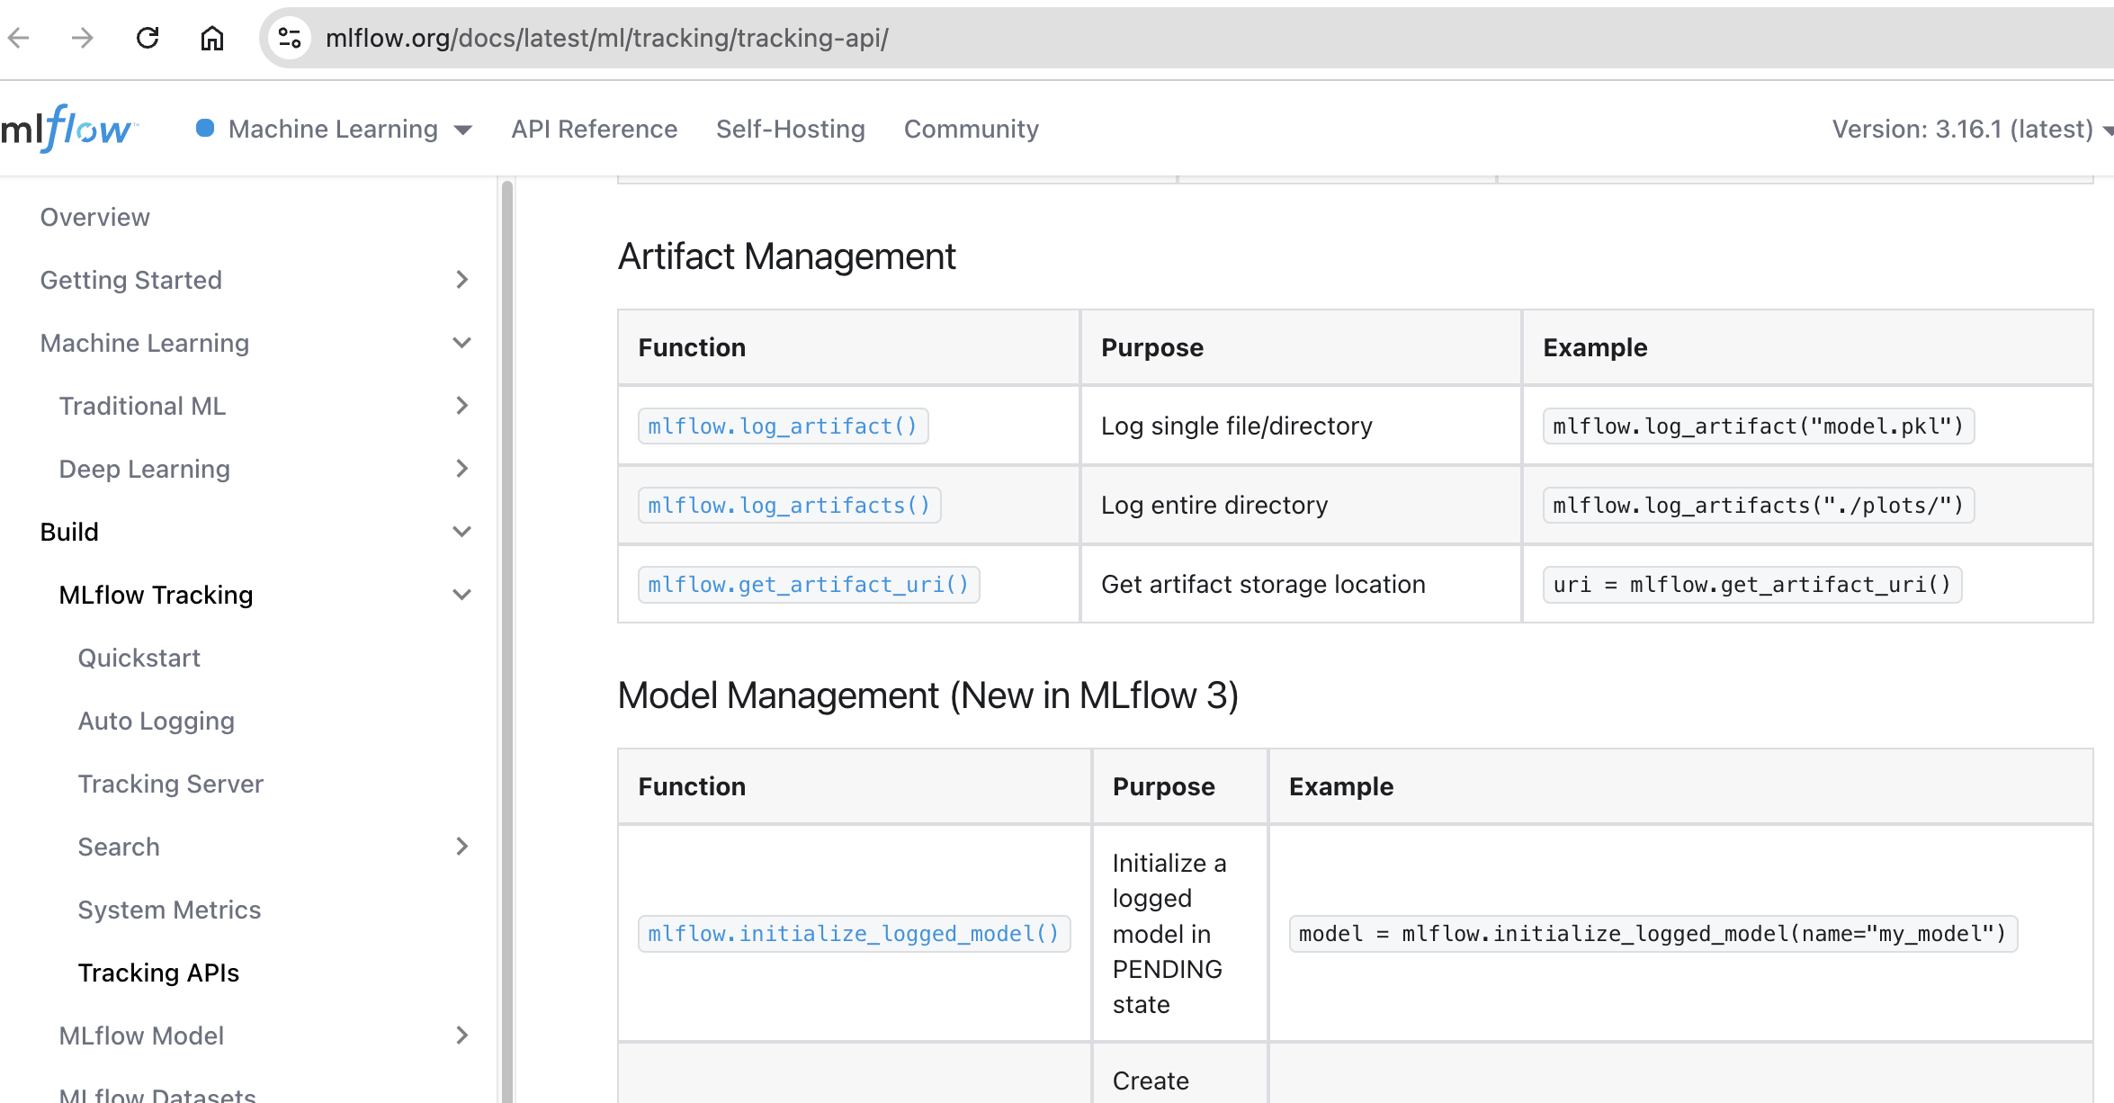
Exploring Experiment Tracking with MLflow
CODE
https://mlflow.org/docs/latest/ml/tracking/tracking-api/ (mlflow_explore_tracking.py)
11

Slide 26
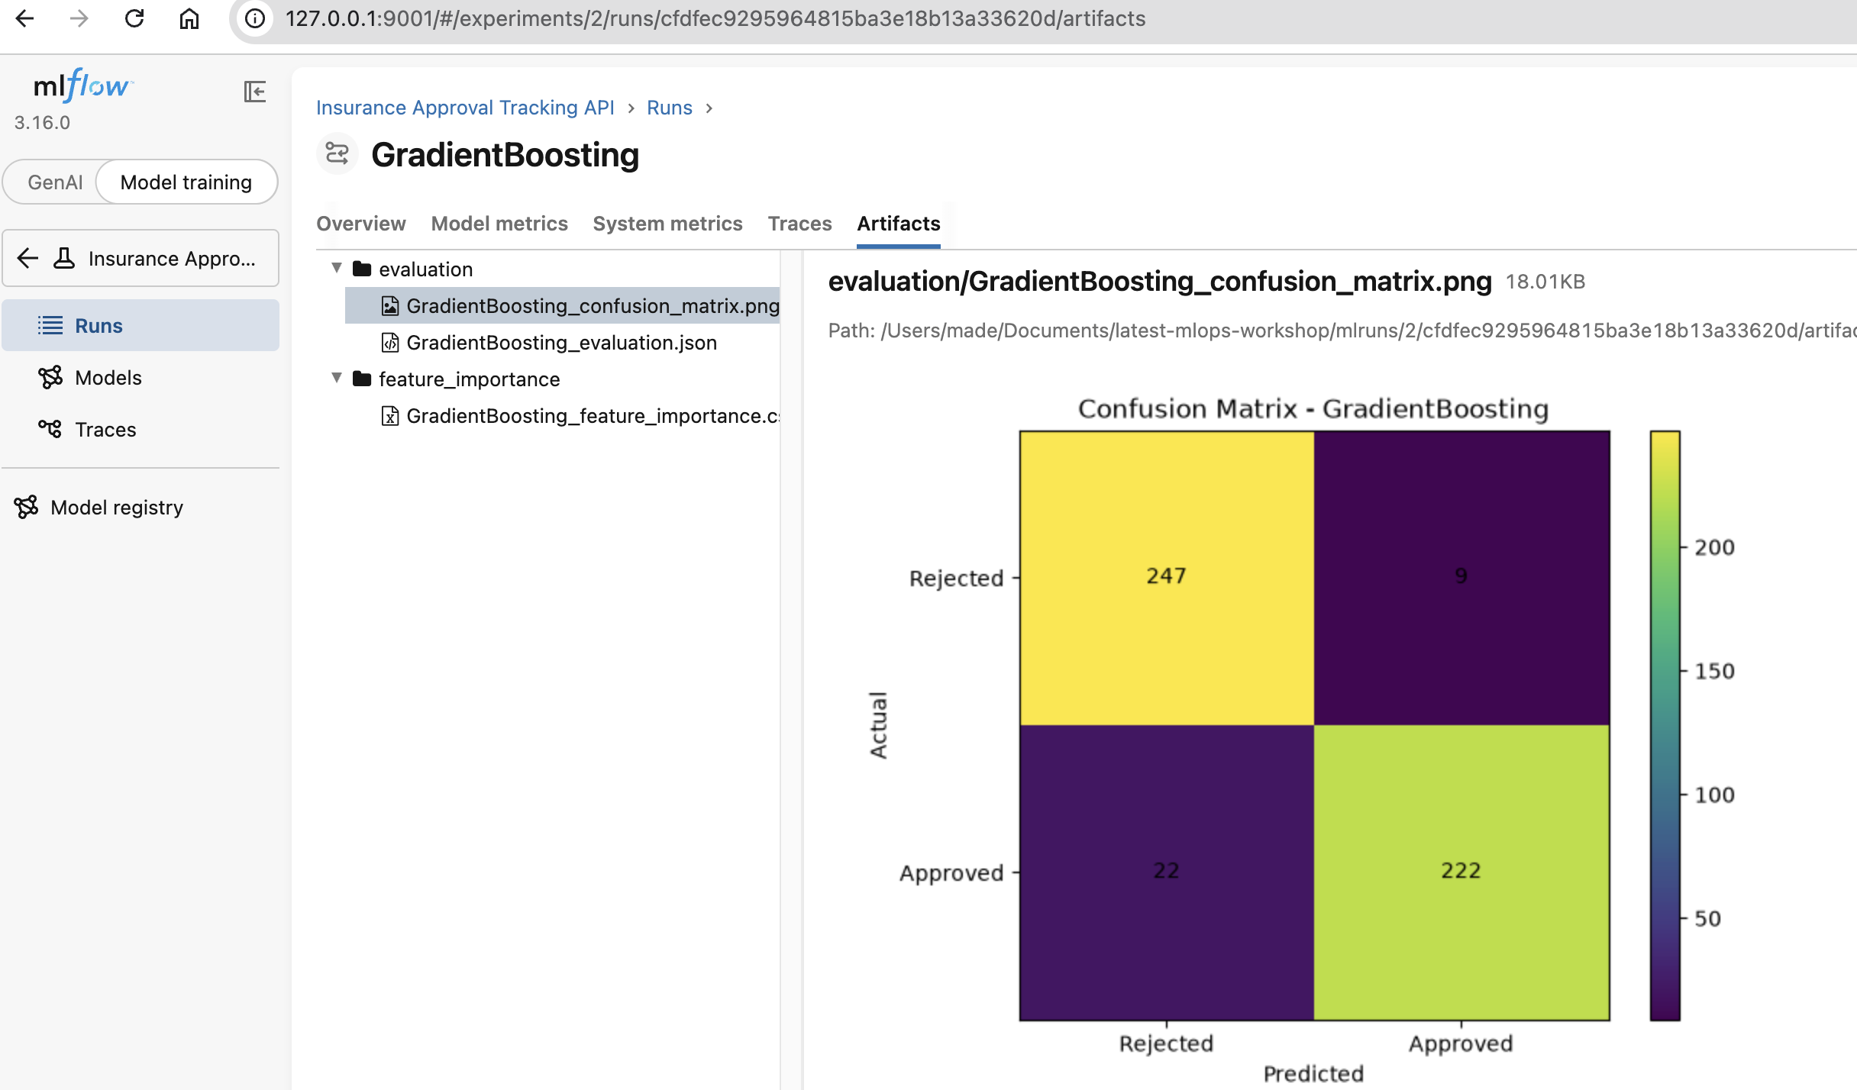
Exploring Experiment Tracking with MLflow
CODE
MLFlow Logging Results
11

Slide 27
MLFlow Model Registry
CODE
A centralized model store, set of APIs, and UI for managing the full ML model lifecycle
Provides lineage, versioning, aliasing, and metadata tagging, so every model has full traceability from the experiment that produced it through to production deployment.
The importance of Model Registry
Version Control | Automatically tracks every model version — compare iterations, roll back, and manage staging vs. production in parallel.
Lineage & Traceability | Each version links back to the MLflow run, logged model, or notebook that produced it — enabling full reproducibility.
Production-Ready Workflows | Aliases (e.g. @champion) and tags support controlled, auditable promotion through experimental, staging, and production.
Governance & Compliance | Structured metadata, tagging, and role-based access control (on managed platforms) support enterprise-grade ML governance.
CORE CONCEPT: MODEL URI
By version
models:/<name>/<version>
e.g. models:/MyModel/1
By alias
models:/<name>@<alias>
e.g. models:/MyModel@champion
12
Notes:
Use model_info.model_uri (MLflow 3). The older runs:/<id>/model pattern still works but prints a warning.

Slide 28
MLFlow Model Registry
CODE
Two ways to register, load by version or alias, and how OSS MLflow compares to Databricks Unity Catalog
register_and_load.py
KEY CONCEPT — MODEL ALIAS
# Option 1 -- register while logging
mlflow.sklearn.log_model(
..., registered_model_name=”model"
)
# Option 2 -- register an already-logged model
mlflow.register_model(
f"runs:/{best_run_id}/model”,"insurance-approval-model")
# Load a specific version
mlflow.sklearn.load_model("models:/model/1")
# Load via alias -- consumer code never changes
mlflow.sklearn.load_model("models:/model@champion")
A mutable, named pointer to one specific model version.
@champion
→
v1
Reassign the alias to point at a new version to roll out a model — the alias name in downstream code and pipelines never changes.
OSS MLFLOW vs. DATABRICKS UNITY CATALOG
Aspect | OSS MLflow | Databricks Unity Catalog
Registry URI | Local / default tracking store | set_registry_uri("databricks-uc")
Governance | Tags & descriptions | Fine-grained RBAC, access policies
Scope | Single tracking store | Cross-workspace shared catalog
Model signature | Optional | Required
Notes:
Use model_info.model_uri (MLflow 3). The older runs:/<id>/model pattern still works but prints a warning.

Slide 29
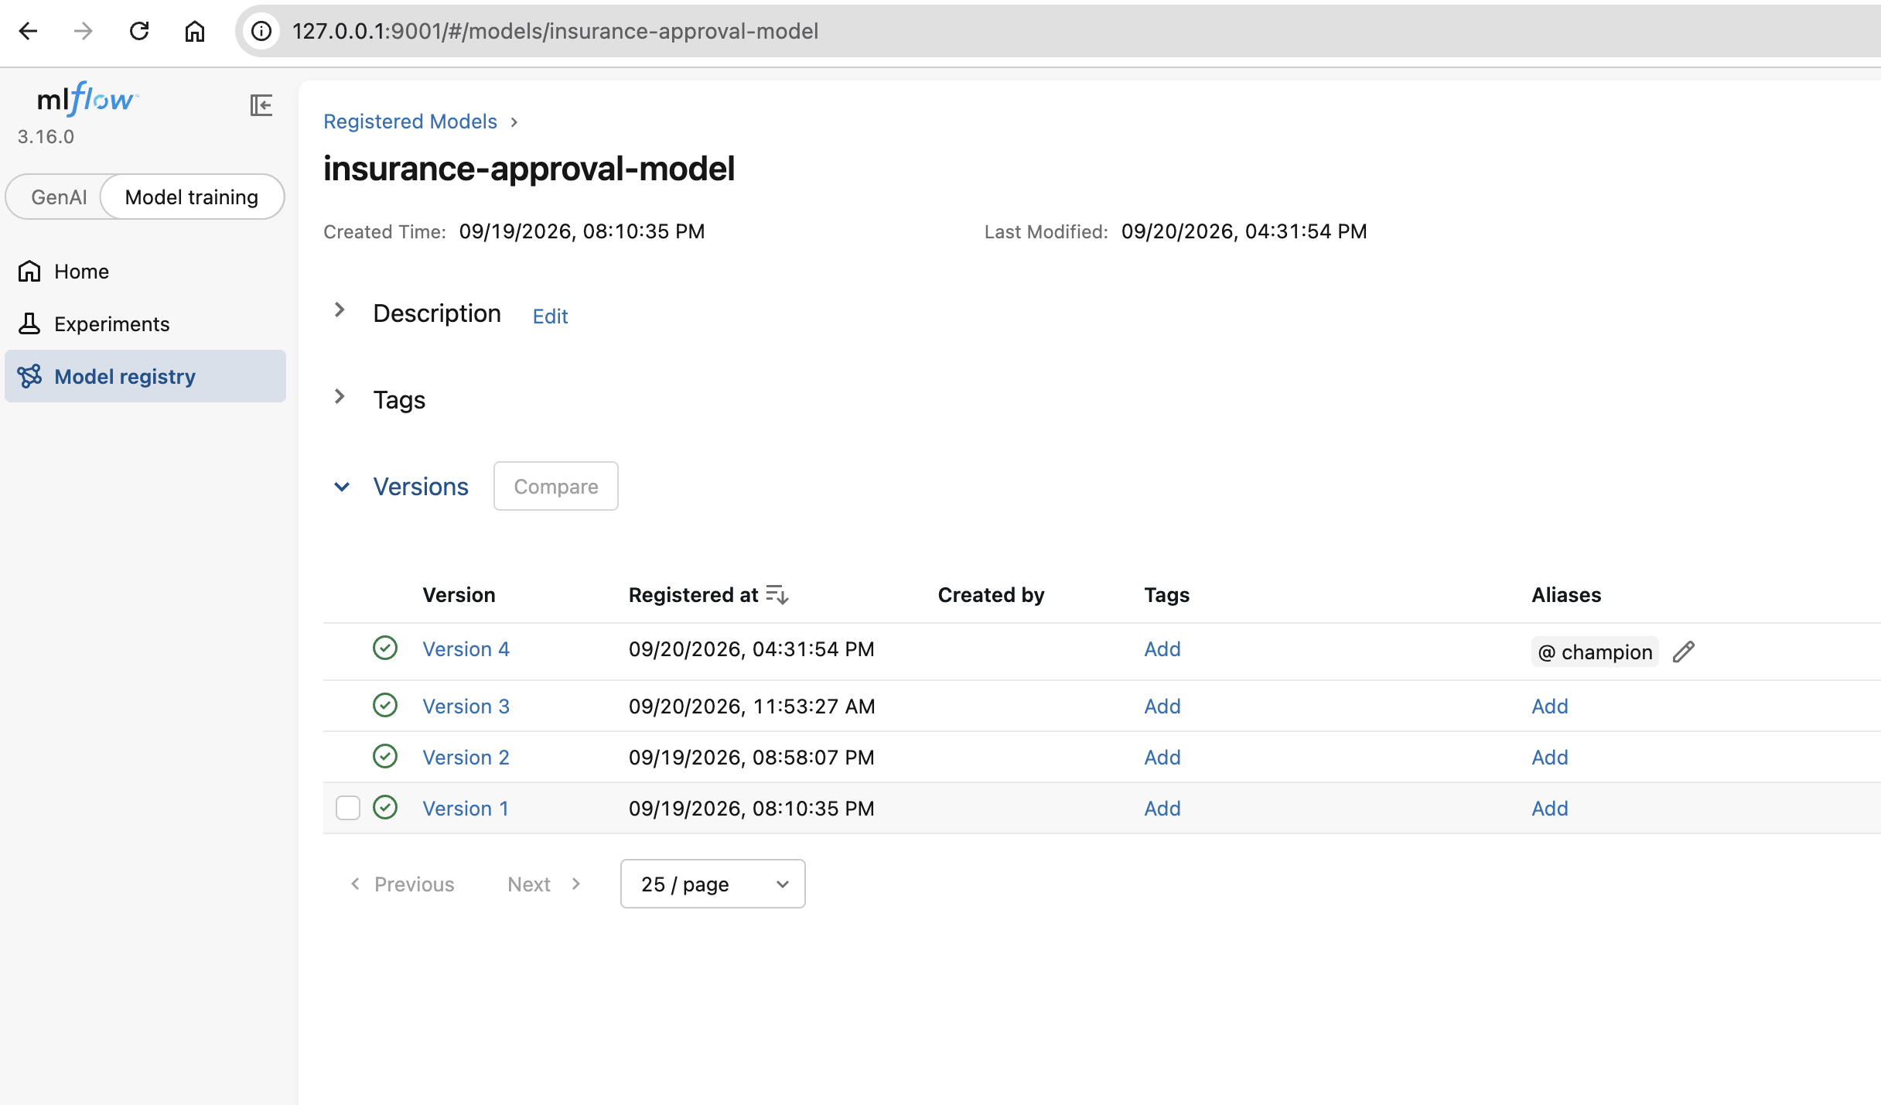
Register the Best Model + @champion Alias
CODE
client.get_model_version_by_alias(MODEL_NAME, ALIAS)
Notes:
Use model_info.model_uri (MLflow 3). The older runs:/<id>/model pattern still works but prints a warning.

Slide 30
Assignments Experiment Tracking with MLflow
CODE
1. Inspect any fatal issue within the train_with_mlflow.py code and explain
2. Improve the code to solve the issue
11

Slide 31
02
IN THIS SESSION
Machine Learning Deployment Strategies
01
Serving patterns
02
FastAPI with a validated contract
03
A self-contained container image
10:45–12:00
04
Deployment strategy

Slide 32
Model Serving Patterns
CONCEPT
Pattern | How it works | When to use it
Real-time (REST/gRPC) | Request in → instant prediction → response | A decision needs an immediate answer, e.g. validation at submission time
Batch | Scheduled predictions over a whole dataset | High volume without an instant need, e.g. periodic risk scoring
Streaming | Predictions on a continuous data stream (Kafka, Pub/Sub) | Data flows constantly, e.g. transaction anomaly detection
Today's hands-on uses the real-time (REST) pattern, because that is what we containerise and deploy.
28

Slide 33
An API Contract with Pydantic
CODE
api/app.py
A two-way contract
class ApplicantData(BaseModel):
age: float = Field(..., examples=[34])
income: float = Field(..., examples=[78000])
bmi: float = Field(..., examples=[24.5])
tenure_months: float = Field(..., examples=[18])
num_claims: float = Field(..., examples=[1])
credit_score: float = Field(..., examples=[720])
policy_value: float = Field(..., examples=[150000])
risk_score: float = Field(..., examples=[42.5])
class PredictionResponse(BaseModel):
approved: bool
probability: float
model_version: str
Requests are validated before the handler runs
Missing field or wrong type → HTTP 422 automatically
response_model keeps the output shape stable
The /docs page is generated from this schema
29
Notes:
Pydantic v2: use examples=[...] and model_dump(). The old style (example=, .dict()) still runs but emits warnings.

Slide 34
Loading the Model & the /predict Endpoint
CODE
api/app.py (abridged)
if os.path.exists(MODEL_PATH): # container path
model = joblib.load(MODEL_PATH) # + model_info.json
else: # local development path
mv = MlflowClient().get_model_version_by_alias(MODEL_NAME, "champion")
model = mlflow.sklearn.load_model(f"models:/{MODEL_NAME}/{mv.version}")
MODEL_VERSION = f"{type(model).__name__}-v{version}"
@app.post("/predict", response_model=PredictionResponse)
def predict(data: ApplicantData):
df = pd.DataFrame([data.model_dump()])
proba = model.predict_proba(df)[0][1]
return PredictionResponse(approved=bool(proba >= 0.5),
probability=round(float(proba), 4),
model_version=MODEL_VERSION)
30
Notes:
model_version is no longer hard-coded: it comes from the version actually loaded. This matters in the incident drill in Session 4.

Slide 35
Run and Test the API
HANDS-ON 2
bash — terminal (real output)
$ make serve # PREDICTION_LOG=logs/predictions.jsonl uvicorn api.app:app --reload
INFO: Uvicorn running on http://127.0.0.1:8000
# second terminal
$ curl http://127.0.0.1:8000/
{"status":"ok","service":"insurance-approval-api",
"model_version":"RandomForestClassifier-v1","model_source":"MLflow Model Registry (@champion)"}
$ curl -X POST http://127.0.0.1:8000/predict -H "Content-Type: application/json" \
-d '{"age":34,"income":78000,"bmi":24.5,"tenure_months":18,
"num_claims":1,"credit_score":720,"policy_value":150000,"risk_score":42.5}'
{"approved":false,"probability":0.4112,"model_version":"RandomForestClassifier-v1"}
31
Notes:
Time: ~10 minutes. make serve uses --reload and writes prediction logs to logs/predictions.jsonl (used in Session 3). Debugging demo: press F5 in VS Code, set a breakpoint on 'proba = model.predict_proba(df)[0][1]' in api/app.py, send the curl request and inspect df. If participants share one network, give each a unique port (e.g. --port 8000 + last digits of their ID) to avoid clashes.

Slide 36
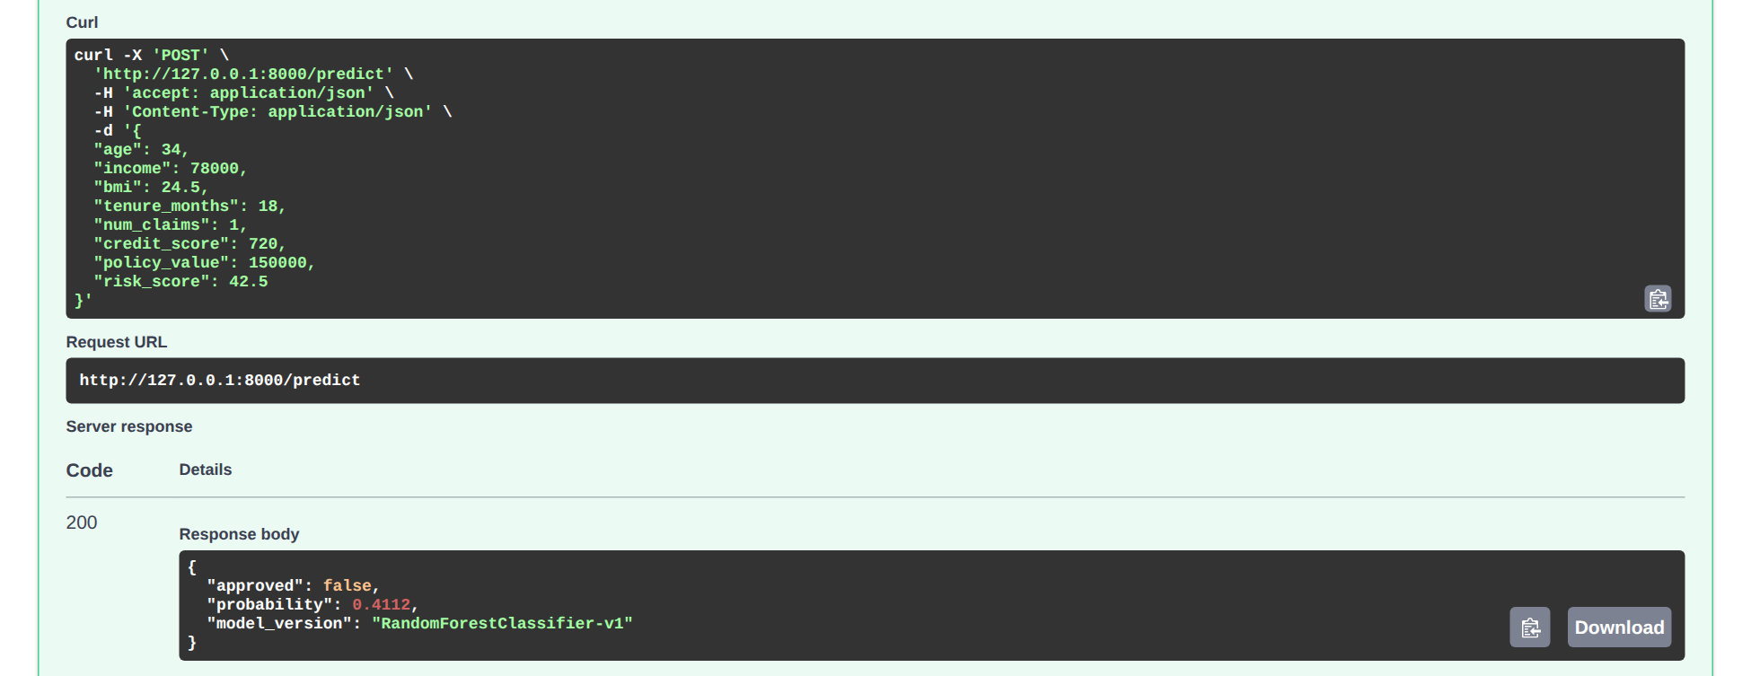
Swagger UI — http://127.0.0.1:8000/docs
REAL SCREENSHOT
Swagger UI loads its assets from a CDN. If the network blocks it, /docs is blank — use curl or make drill-check instead.
32
Notes:
Demo: open /predict → Try it out (the body is pre-filled from the examples) → Execute. Swagger shows the curl command, request URL and response; model_version shows which version is serving. Network note: Swagger UI loads its CSS/JS from the jsdelivr CDN. If the office network blocks it, /docs will be blank, so keep curl as a fallback.

Slide 37
Invalid Requests Are Rejected Automatically
VALIDATION
01
Missing field
02
Wrong type
03
Structured errors
A request without credit_score → HTTP 422, with no extra validation code.
credit_score = "high" is rejected before predict() ever runs.
The 422 body names the field and the reason — easy for client teams to fix.
# real response when credit_score is missing
{"detail":[{"type":"missing","loc":["body","credit_score"],"msg":"Field required", ...}]}
# real response when credit_score = "high"
{"detail":[{"type":"float_parsing","loc":["body","credit_score"],
"msg":"Input should be a valid number, unable to parse string as a number","input":"high"}]}
33

Slide 38
From the Registry to a Self-Contained Image
CONTAINERISATION
step 0 — export (real output)
docker/Dockerfile
$ make export
Model 'insurance-approval-model'
version 1 (RandomForestClassifier)
exported to api/models/model.pkl
# api/models/model_info.json
{
"model_name": "insurance-approval-model",
"version": "1",
"model_class": "RandomForestClassifier",
"run_id": "..."
}
FROM python:3.11-slim
WORKDIR /app
# requirements first -> cached pip layer
COPY api/requirements.txt .
RUN pip install --no-cache-dir \
-r requirements.txt
COPY api/app.py .
COPY api/models/ ./models/
ENV PORT=8080
# exec: uvicorn is PID 1, receives SIGTERM
CMD exec uvicorn app:app \
--host 0.0.0.0 --port ${PORT}
34
Notes:
Container basics were covered on Day 2. The point here: the image must not depend on the developer's mlflow.db.

Slide 39
Build & Run the Container Locally
HANDS-ON 3
bash — terminal
$ make docker-build # docker build -f docker/Dockerfile -t insurance-api .
$ make docker-run # docker run -d -p 8080:8080 --name api insurance-api
$ python3 scripts/test_deployment.py http://127.0.0.1:8080
>> Health check...
200 {'status': 'ok', ..., 'model_version': 'RandomForestClassifier-v1',
'model_source': 'local file (api/models/model.pkl)'}
>> Predict (compare elapsed time for cold vs warm start)...
200 {'approved': False, 'probability': 0.4112, 'model_version': 'RandomForestClassifier-v1'}
$ docker stop api && docker rm api
Layer caching
model_source
Change one line in app.py and rebuild: the pip install layer stays CACHED.
Must say "local file" — proof that the image does not depend on MLflow.
35
Notes:
Time: ~10 minutes. Extra demo: docker exec -it api /bin/bash, then ls models/ to show model.pkl inside the image. The image uses api/requirements.txt, which does NOT include mlflow. The image runtime was tested; docker build itself could not be run in the authoring sandbox, so test it on the classroom machines.

Slide 40
Safely Replacing a Model in Production
RELEASE STRATEGIES
Strategy | How it works | Strength | Risk / cost
Recreate | Stop the old version, start the new one | Simplest | Downtime; slow rollback
Blue/Green | Two identical environments; switch traffic at once | Instant rollback | Double capacity
Canary | The new version gets a small share of traffic (e.g. 10%) | Limited blast radius | Needs per-version monitoring
Shadow | The new version gets a copy of traffic; its output is ignored | Zero user risk | Double compute cost
A/B test | Traffic split at random; impact compared statistically | Measures business impact | Needs volume & experiment design
38
Notes:
Monitoring tells you WHEN to replace a model; the release strategy decides HOW to replace it safely.

Slide 41
IN THIS SESSION
03
01
Monitoring vs observability
Monitoring and Observability
02
Structured prediction logs
03
Data drift with Evidently AI
04
Reading the drift report
13:15–14:45
05
Retraining policy

Slide 42
Monitoring vs Observability
CONCEPT
Monitoring
Observability
Answers: is the system healthy?
Answers: why is it behaving this way?
Predefined metrics and thresholds
Alerts when a threshold is crossed
Example: p95 latency > 500 ms, drift > 30%
Context-rich logs, metrics and traces
Lets you investigate problems you did not predict
Example: per-prediction logs with model version & features
What to watch in an ML system
Service
latency · errors · traffic
→
Data
feature distributions
→
Model
prediction quality
→
Business
decision impact
42

Slide 43
Evidently Major Monitoring Capabilities
TAXONOMY
No | Area | What it answers?
1 | Data Quality | Is the incoming data valid? → Is there any missing data, invalid data, invalid format?
2 | Data Drift | Has input distribution changed?
3 | Prediction Drift | Has model output changed?
4 | Model Performance | Is the model still accurate?
5 | Model Quality | Is the model behaving acceptably according to domain metrics? → Define threshold requirements
43

Slide 44
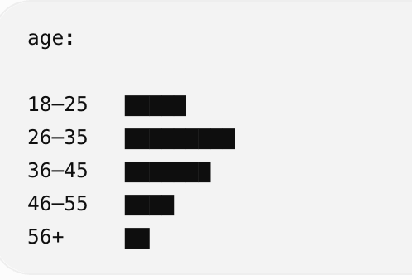
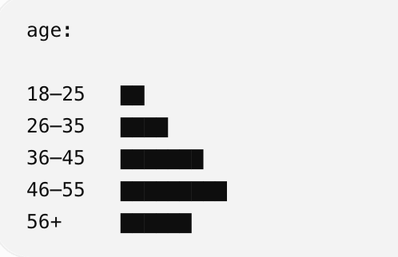
Data Drift
TAXONOMY
VS.
Data for training and evaluation
Data production
Evidently can compare: Reference dataset VS Current production dataset
43

Slide 45
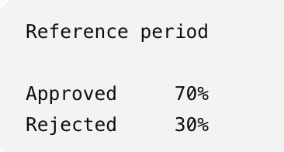
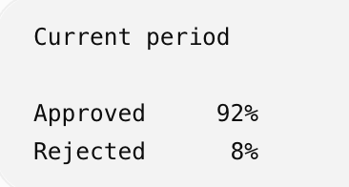
Prediction Drift
TAXONOMY
VS.
Testing results during development
Prediction results in production
Evidently can monitor the prediction results in production and compared with reference values populated during model development
43

Slide 46
Model Performance Monitoring
TAXONOMY
Evidently monitors model performance based on pre-defined metrics
Classification | Regression
Accuracy Precision Recall F1 ROC-AUC confusion matrix calibration-related measures | MAE ME RMSE error distributions error normality error bias
The prediction in production is compared with the ground truth to measure model performance
43

Slide 47
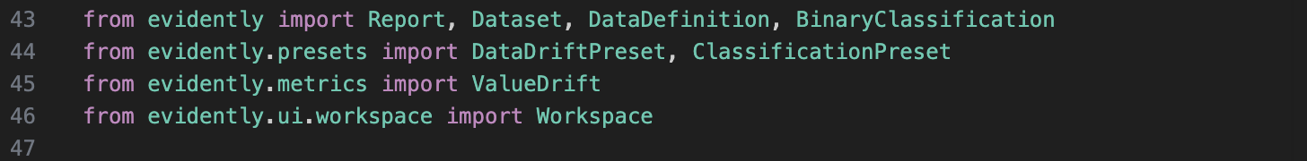
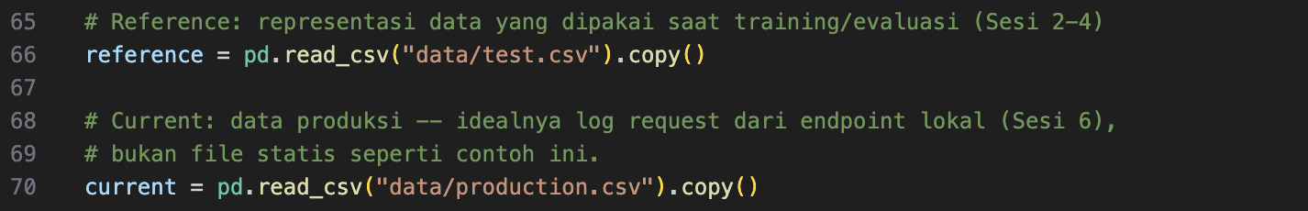
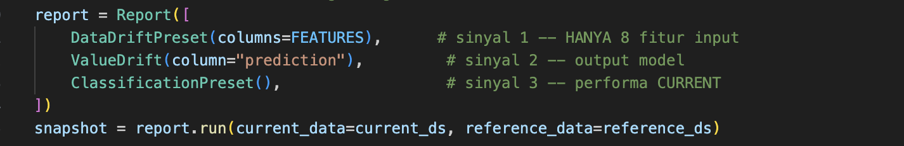
Evidently Sequence for Running Monitoring
OBSERVABILITY
44
Notes:
On Cloud Run, JSON lines on stdout are picked up by Cloud Logging automatically. For sensitive DJP data, never log identifiers (NPWP, names); mask or hash them first.

Slide 48
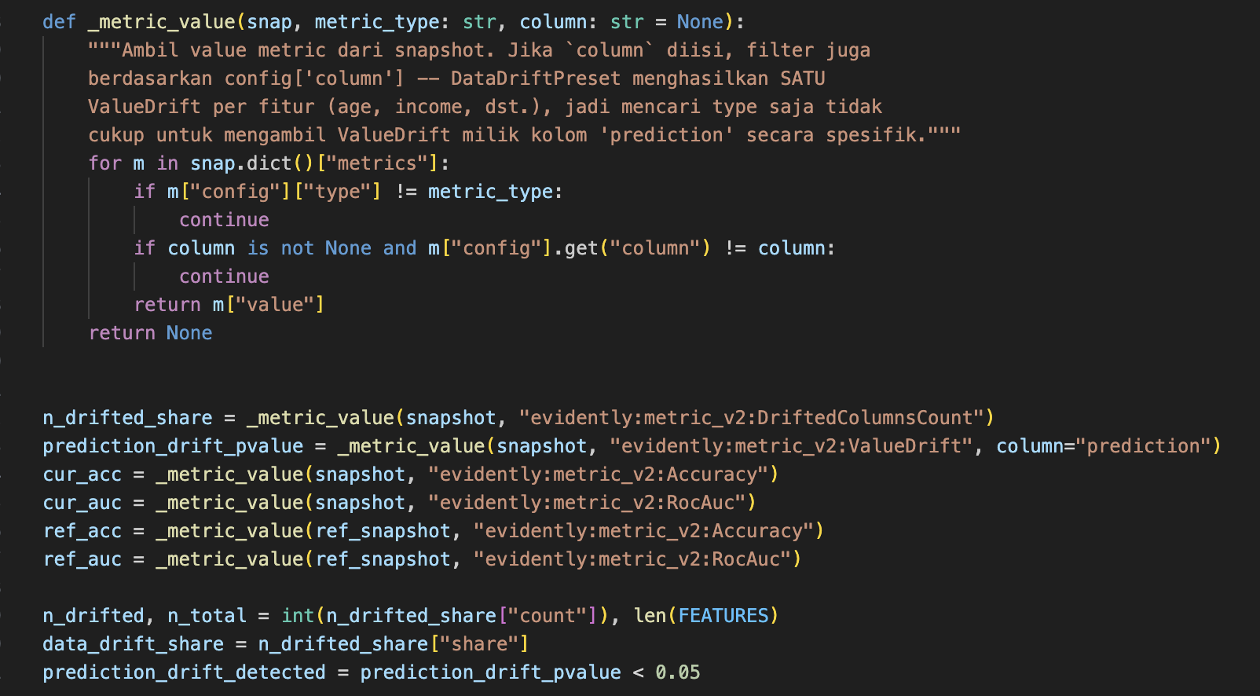
Calculating Drift
CODE
46

Slide 49
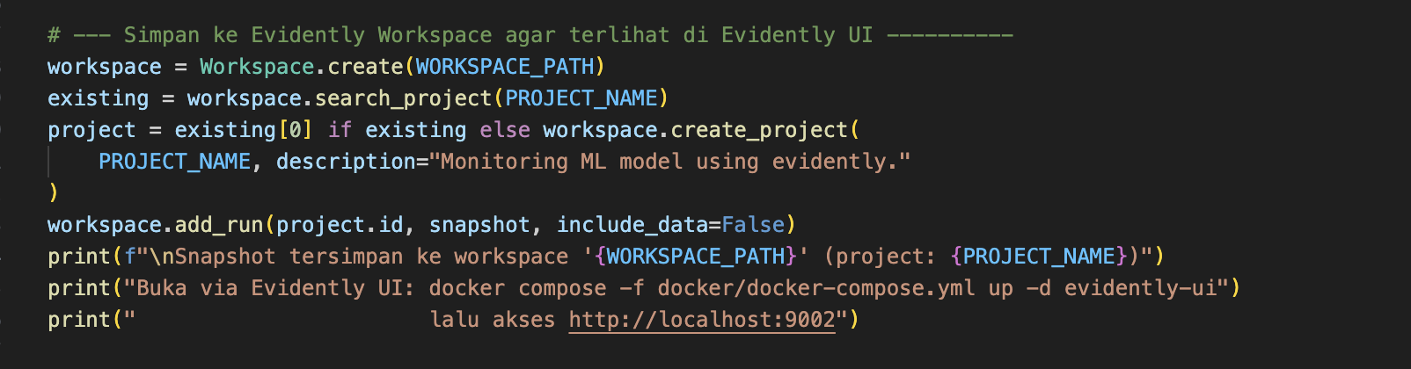
Storing Report to Local vs Workspace
HANDS-ON 4
47
Notes:
Time: ~15 minutes. For logs/predictions.jsonl to contain data, send some requests from production.csv while make serve is running (or run make drill-check).

Slide 50
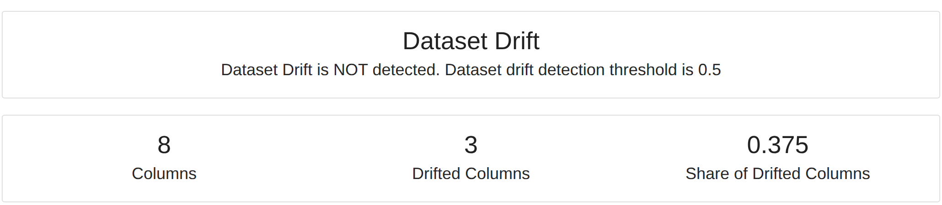
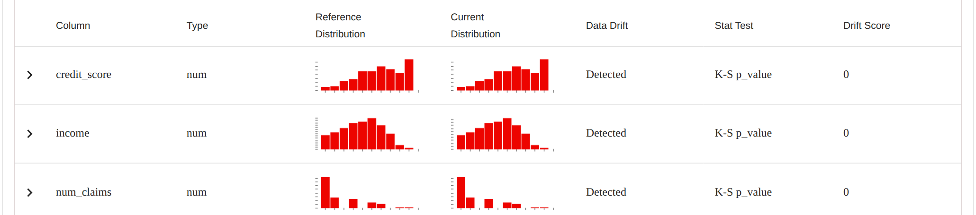
The Evidently Drift Report
REAL SCREENSHOT
Check drift_report.html or execute run_evidently_service.sh → localhost:9002
48
Notes:
The table is sorted by Data Drift so the drifted columns appear first.

Slide 51
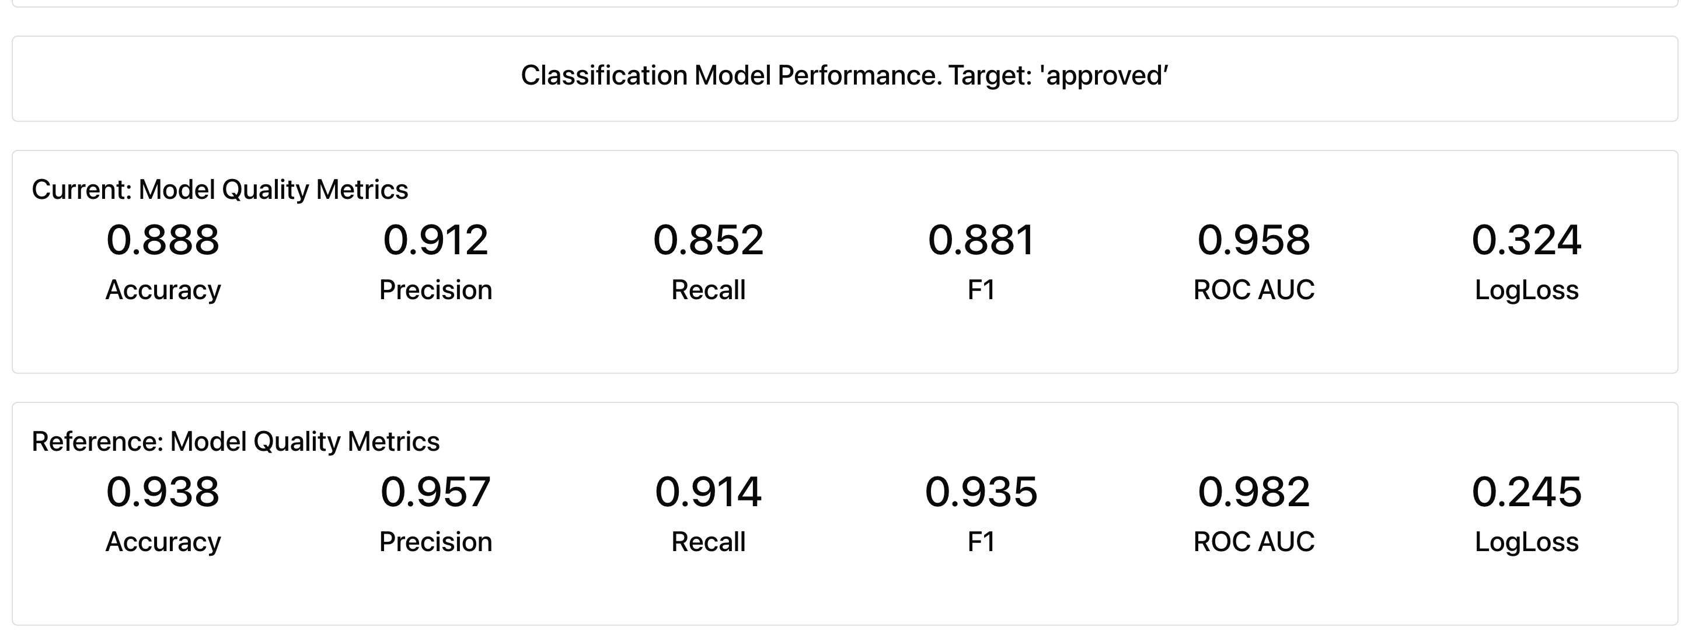
The Evidently Drift Report
REAL SCREENSHOT
Check drift_report.html or execute run_evidently_service.sh → localhost:9002
48
Notes:
The table is sorted by Data Drift so the drifted columns appear first.

Slide 52
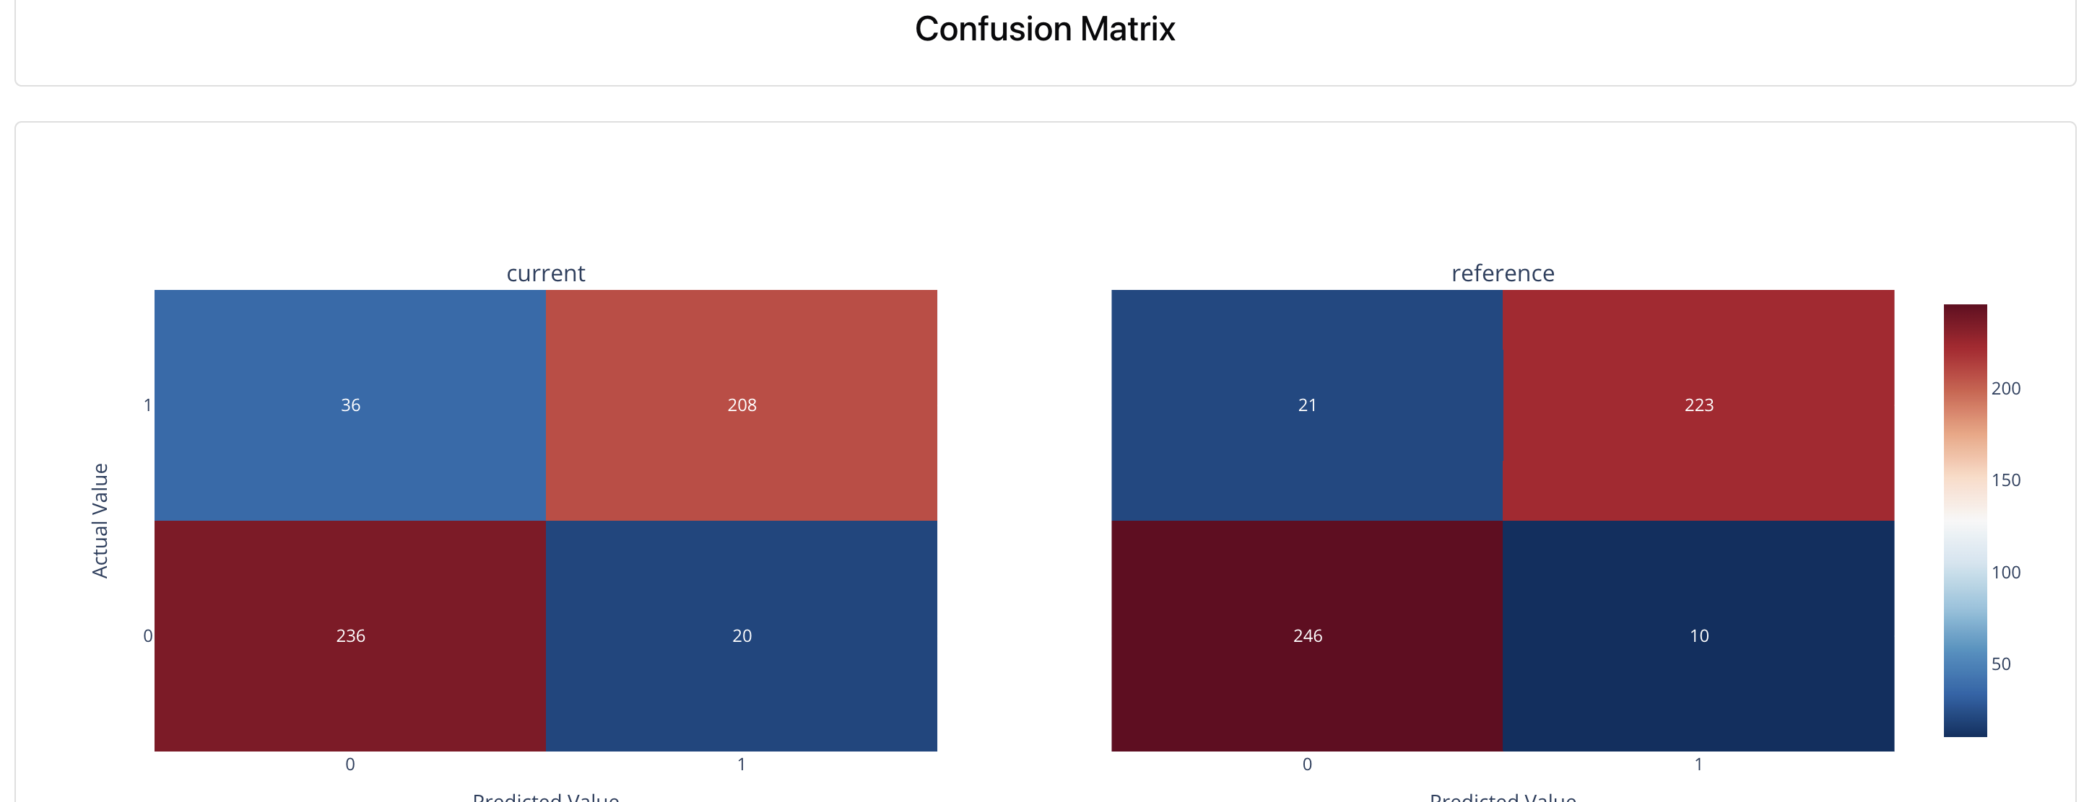
The Evidently Drift Report
REAL SCREENSHOT
Check drift_report.html or execute run_evidently_service.sh → localhost:9002
48
Notes:
The table is sorted by Data Drift so the drifted columns appear first.

Slide 53
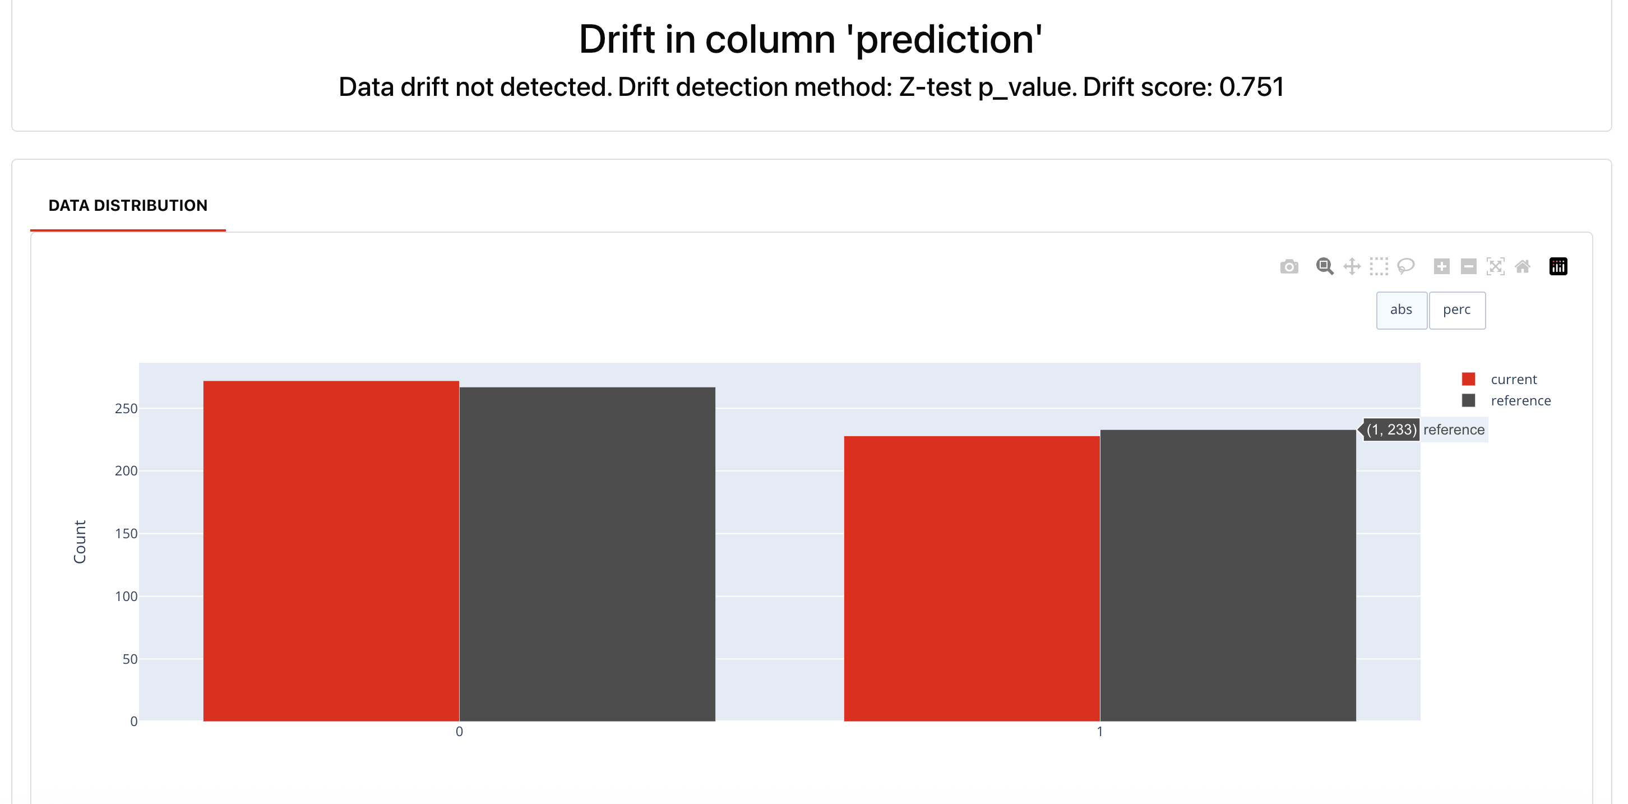
The Evidently Drift Report
REAL SCREENSHOT
Check drift_report.html or execute run_evidently_service.sh → localhost:9002
48
Notes:
The table is sorted by Data Drift so the drifted columns appear first.

Slide 54
Reading the Results
INTERPRETATION
01
3 of 8 columns drifted
02
Share 0.375 < 0.5
income, num_claims, credit_score — K-S p-value = 0, exactly the three features that were shifted.
Below Evidently's default threshold, so the overall status reads "Dataset Drift NOT detected".
03
5 stable columns
04
Implication
age, bmi, policy_value, risk_score, tenure_months were not shifted — p-value = 1.
The aggregate status can mislead. A retraining policy should also watch key features individually.
49

Slide 55
Defining a Retraining Policy
OPERATING POLICY
01
Set a threshold, e.g. retrain if ≥30% of columns drift for 3 consecutive days
02
Run orchestration/pipeline.py daily (a Prefect schedule or Cloud Run Jobs)
03
Store report.as_dict() in a table to see trends, not just snapshots
04
When the threshold is crossed, trigger the training pipeline (Session 1) on fresh data
05
The new model becomes @challenger → passes the quality gate → canary → @champion
50
Notes:
This closes the MLOps loop: monitoring (Session 3) triggers retraining (Session 1), which is released again (Session 2).

Slide 56
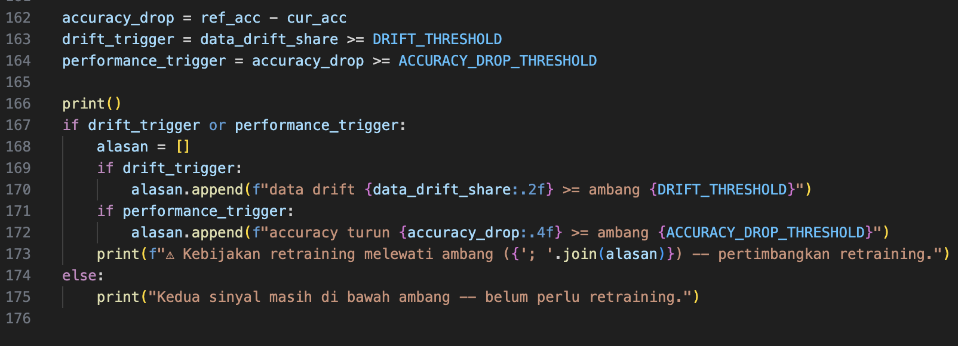
Our Simple Policy
HANDS-ON 4
We will use this result for defining automation flow with prefect
47
Notes:
Time: ~15 minutes. For logs/predictions.jsonl to contain data, send some requests from production.csv while make serve is running (or run make drill-check).

Slide 57
04
IN THIS SESSION
Orchestration
01
Prefect configuration and running server
02
Defining prefect flow
03
Create automation with prefect
15:00–15:40
04
Exercise and discussion

Slide 58
When Should a Model Be Retrained?
CONTINUOUS TRAINING
01
On a schedule
02
New data arrives
Retrain daily, weekly or monthly. Simple, but wasteful when the data has not changed.
Retrain when a new batch of labelled data lands, e.g. at every period close.
03
Drift detected
04
Performance drops
Retrain when monitoring shows feature distributions shifting past a threshold (Session 3).
Retrain when live metrics (with ground truth) fall below the agreed threshold.
Whatever the trigger, a retrained model must pass the same quality gate before it becomes @champion.
18
Notes:
The CT triggers connect to monitoring in Session 3.

Slide 59
Manual Orchestration Is Maturity Level 0
PROBLEM
Check drift
monitor.py
→
Retrain
train_with_mlflow.py
→
Check quality
quality_gate.py
→
Export
export_model.py
→
Deploy
Local_deploy.sh
A person reads the output and decides
Run when someone remembers
Easy to skip under time pressure
The bridge step that gets forgotten
No retry when the network fails
Each arrow is a human decision, not code. The retraining policy exists only as a sentence in a document.
Orchestration moves the arrows into code: order, conditions, retries and history.
19
Notes:
Every arrow between these steps lives in someone's head. If monitor.py reports drift in 3/8 columns, nothing happens automatically -- exactly Level 0 of the maturity model from Day 1.

Slide 60
What an Orchestrator Adds
CONCEPT
01
Scheduling
02
Conditional branching
The pipeline runs every night at 02:00, not whenever an engineer remembers to run it.
"Release ONLY IF the candidate passes the gate" — logic that used to live in someone's head.
03
Closing the loop
04
Retries & history
The retraining policy from Session 3 ("retrain if ≥30% of columns drift") is actually executed.
A flaky gcloud call is retried automatically; every run is recorded and can be audited in a UI.
20

Slide 61
Orchestration Tools: Infrastructure Trade-offs
COMPARISON
Tool | Execution model | Infrastructure required | When to choose it
Airflow | Scheduler + static DAGs | Metadata DB (Postgres), webserver, scheduler | Many non-ML pipelines already; one central scheduler
Kubeflow Pipelines | One container per step on K8s | A Kubernetes cluster | Steps need large resources (GPUs) each
Prefect | Native Python, dynamic | None to start — @flow is a Python function | Small-to-medium teams; no extra servers
ZenML | Abstraction over other tools | Local SQLite for the basics | Gradual migration reusing existing MLflow/storage
We use Prefect today because it is a plain pip install. The design ideas carry over to Airflow or Kubeflow unchanged.
21
Notes:
For basic orchestration all four are interchangeable. The difference is the infrastructure needed to run them. If DJP already operates Airflow for data pipelines, reusing it is usually the right call.

Slide 62
A Prefect Flow with a Quality Gate
CODE
orchestration/pipeline.py (abridged)
What Prefect adds
@task(retries=2, retry_delay_seconds=5, log_prints=True)
def check_drift() -> bool:
return "exceeds threshold" in _run([PY, "monitoring/monitor.py"])
@task(retries=3, retry_delay_seconds=10, log_prints=True)
def deploy():
_run(["bash", "docker/deploy.sh"])
@flow(name="insurance-approval-retraining", log_prints=True)
def mlops_pipeline():
if not check_drift():
return # nothing to do
previous = _champion_version()
retrain()
if not quality_gate():
rollback(previous) # never release a failing candidate
return
export_model()
if os.getenv("PROJECT_ID"):
deploy()
if __name__ == "__main__":
mlops_pipeline.serve(
name="insurance-approval-test",
interval=60,
)
@task: retries, timing and logs per step
@flow: the order and the if-branches live in code
_run() shows a failing step's stderr instead of hiding it
Deploy runs only when PROJECT_ID is set
In this snippset the monitoring will be executed once every 60 seconds. Note that prefect process can be placed as Cron job.
22
Notes:
No ML logic is rewritten: every task calls a script that already exists. Note the gate: the original course code released a retrained model without one. Design note: here training moves @champion and the flow restores it if the gate fails; in production, register the candidate as @challenger and promote it only after the gate.

Slide 63
05
Incident Handling
IN THIS SESSION
01
Types of ML incidents
02
Contoh Kategori Insiden MLOps
15:40–16:00
03
Level Kritikalitas Insiden

Slide 64
Types of Incidents in ML Systems
CONCEPT
01
Model quality
02
Data pipeline
The model makes wrong predictions at scale: a bad release or sudden concept drift.
Wrong joins, swapped columns, shuffled labels, late data — the model is trained on broken data.
03
Service & infrastructure
04
Security & privacy
Endpoint down, latency spikes, repeated cold starts, exhausted cloud quota.
Sensitive data leaking through logs, unauthorised access, attacks on the model (MLSecOps, Day 1).
54

Slide 65
Typical ML related incidents
CONCEPT
Tidak ada crash, tidak ada error code
Endpoint tetap mengembalikan HTTP 200, namun jawabannya yang perlahan menjadi tidak akurat, server tetap berjalan
Baseline yang bergeser tanpa terdeteksi
Perubahan pada lingkungan operasi (musiman, perilaku pengguna, kondisi ekonomi), asumsi training tidak lagi berlaku, dimana perubahan ini tidak terprediksi
Monitoring tradisional gagal menangkapnya
CPU, latency, error rate semua tampak normal, sehingga dibutuhkan instrumentasi khusus untuk melihat penurunan yang sesungguhnya
Pola silent failure adalah hal normal
Prediction drift TIDAK terdeteksi, padahal nilai accuracy model telah turun 5%.
54

Slide 66
Contoh Kategori Insiden MLOps
CONCEPT
Kategori | Phase | Contoh Insiden | Dampak
Data & Model | Model Development | Data drift, prediction drift diam-diam, alias registry menunjuk versi salah | Keputusan bisnis salah tanpa disadari
Serving Infrastructure | Model Deployment | API crash, breaking change dependency, container gagal start | Layanan tidak bisa diakses
Pipeline & Orchestration | Orkestrasi | Model buruk ter-promosi otomatis, task gagal diam-diam, retry exhaust | Otomasi mempercepat kesalahan, bukan cuma layanan
Monitoring Blind Spot | Model Monitoring | Satu sinyal saja dipasang, threshold salah kalibrasi, alert fatigue | Insiden nyata luput terdeteksi sama sekali
54

Slide 67
Level Kritikalitas Insiden
CONCEPT
Level | Kriteria | Contoh pada materi Workshop | Target Response
Kritis | Layanan down / keputusan salah massal | insurance-api tidak merespons, atau meloloskan/menolak semua permohonan | Segera, hentikan pekerjaan lain
Tinggi | Performa turun signifikan, terkonfirmasi | Accuracy turun ≥0.03 terkonfirmasi ground truth | < 1 jam
Sedang | Drift terdeteksi, masih dalam batas aman | Data drift share < 0.30, belum memicu kebijakan retraining | Investigasi terjadwal
Rendah | Anomali kecil, sifatnya informasional | Satu fitur bergeser tapi tidak signifikan secara statistik | Catat, review berkala
Tools Model Regsitry dan Monitoring membantu kita dalam menghadapi insiden. Melalui monitoring berkelanjutan silent failure dapat dideteksi lebih awal. Model registry mendukung proses rollback yang cepat.
54

Slide 68
Thank you!
Any question?

